Slide 1


Slide 2
Who’s this guy?
Harikrishnan
cnharishkrish@gmail.com
https://www.linkedin.com/in/hari-krishnan-304a0272
cn_harikrishnan

Slide 3
Agenda
What is Xamarin?
Why Xamarin?
Data Binding
Dependency Service
Custom Renderers
Custom Control

Slide 4
Why
Xamarin?

Slide 5


Slide 6


Slide 7


Slide 8
Meet Xamarin.Forms
Build native UIs for iOS, Android, and Windows
from a single, shared C# codebase.

Slide 9
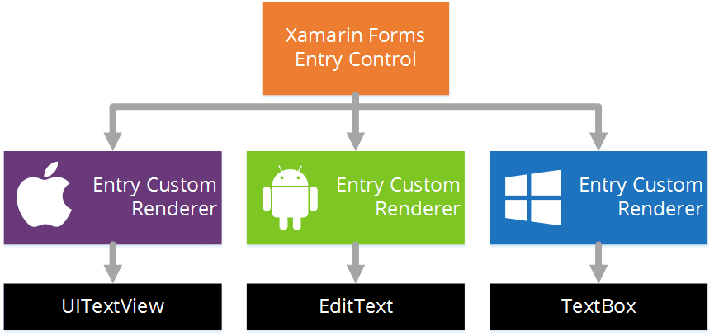
Xamarin Forms Rendering Model - Entry

Slide 10
Advantages

Slide 11

Write Once, Run Anywhere

Slide 12
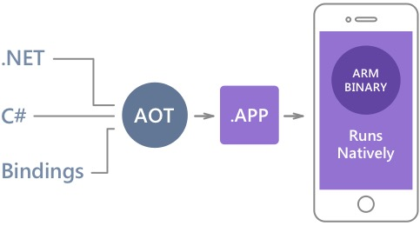
Native Performance
Xamarin.iOS does full Ahead Of Time (AOT) compilation to produce an ARM binary for Apple’s App Store.
Xamarin.Android takes advantage of Just In Time (JIT) compilation on the Android device.

Slide 13
✓Always Up-to-Date
Same-day support:
iOS 8
iOS 9
iOS 10
iOS 11
iOS 12
Full support for:
Apple Watch
Android Wear
Amazon Fire TV
Google Glass
and much more

Slide 14
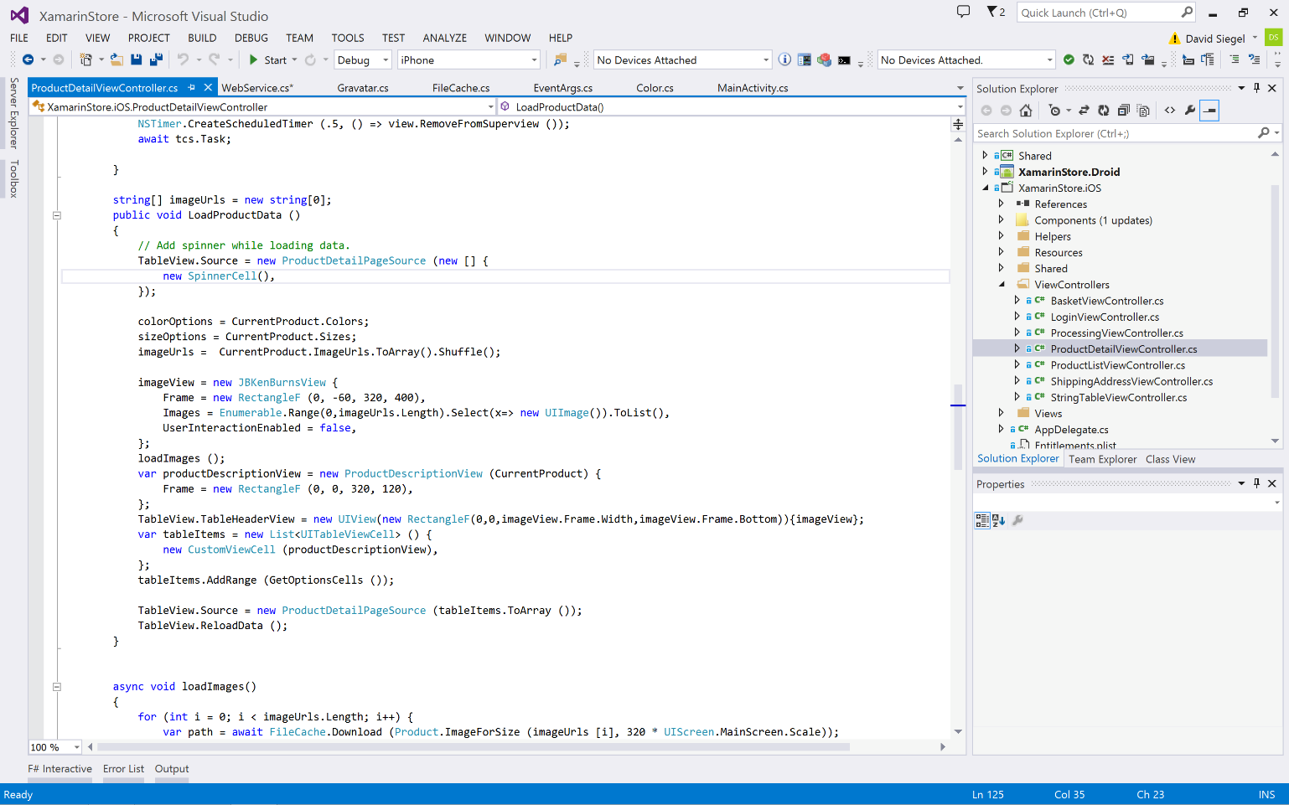
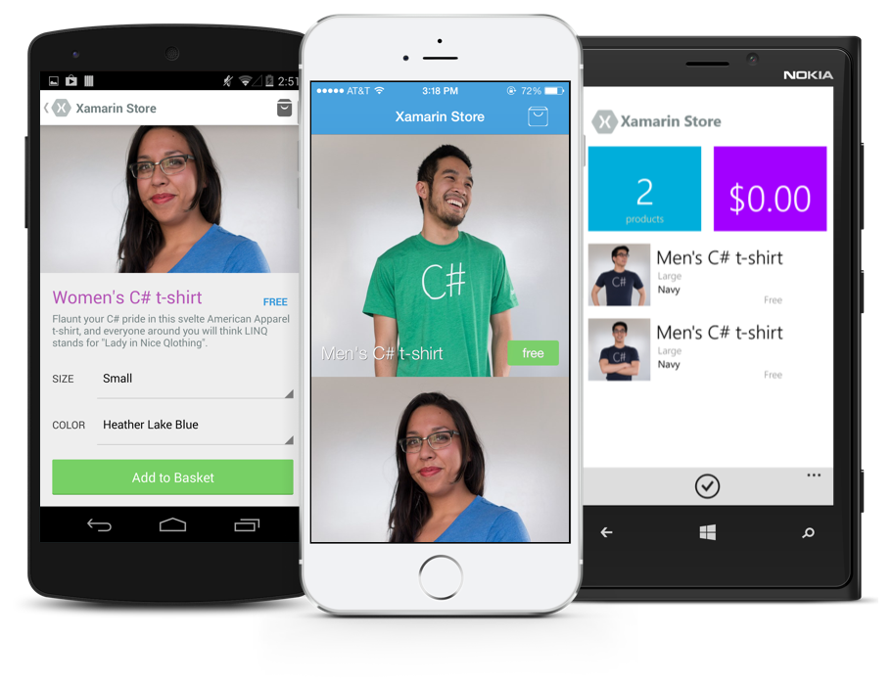
Anything you can do in Objective-C, Swift, or Java can be done in C# and Visual Studio with Xamarin.
Notes:
Coming up next is bubbles

Slide 15

Xamarin + Xamarin.Forms
iOS C# UI
Android C# UI
Windows C# UI
Shared UI Code
Shared C# Backend
Shared C# Backend
Traditional Xamarin Approach
With Xamarin.Forms: More code-sharing, all native

Slide 16
What’s included
✓ 40+ Pages, layouts, and controls
(Build from code behind or XAML)
✓ Two-way data binding
✓ Navigation
✓ Animation API
✓ Dependency Service
✓ Messaging Center
Shared UI Code
Shared C# Backend

Slide 17
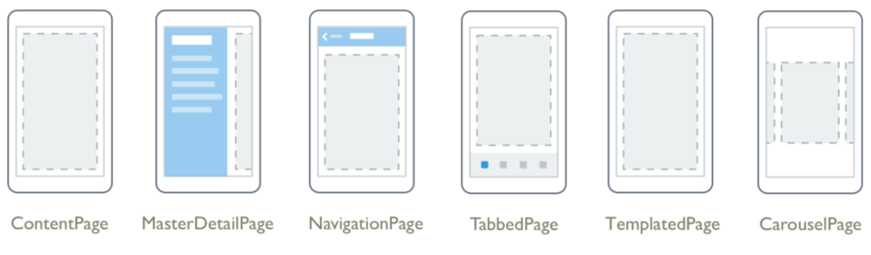
Pages

Slide 18
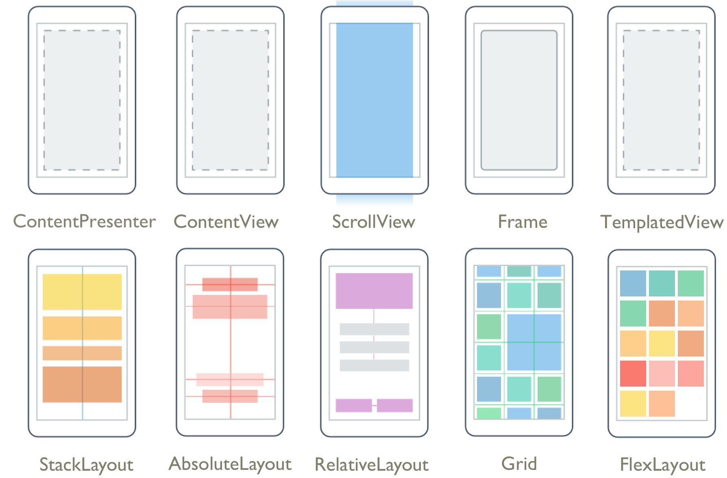
Layouts

Slide 19
Controls
ActivityIndicator
BoxView
Button
DatePicker
Editor
Entry
Image
Label
ListView
Map
OpenGLView
Picker
ProgressBar
SearchBar
Slider
Stepper
TableView
TimePicker
WebView
EntryCell
ImageCell
SwitchCell
TextCell
ViewCell

Slide 20

New Platforms
Samsung Tizen
Televisions, Wearables, Mobile
macOS
WPF
Linux: GTK#
Notes:
At the end of talking through this, I’ll do a quick intro of Jason and call him up to demo.

Slide 21
Data Binding
Link properties of two objects
so that changes in one property automatically reflects in the other
Integral part of the Model-View-ViewModel (MVVM)
Each view can have only one BindingContext
All data bindings on that view must all reference properties of the same object

Slide 22
Binding Modes
Default
OneWay — values are transferred from the source to the target
OneWayToSource — values are transferred from the target to the source
TwoWay — values are transferred both ways between source and target
OneTime — data goes from source to target, but only when the BindingContext changes

Slide 23
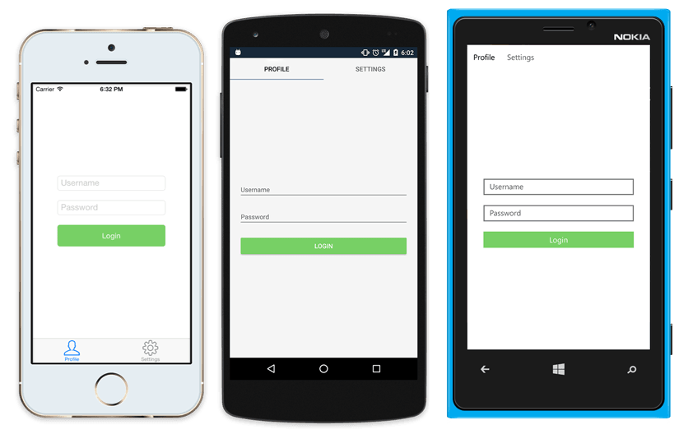
Native UI from shared code
<?xml version="1.0" encoding="UTF-8"?>
<TabbedPage xmlns="http://xamarin.com/schemas/2014/forms"
xmlns:x="http://schemas.microsoft.com/winfx/2009/xaml"
xmlns:local="clr-namespace:XamarinDemo"
x:Class="XamarinDemo.MainPage">
<TabbedPage.Children>
<ContentPage Title="Profile" Icon="Profile.png">
<StackLayout Spacing="20" Padding="20“ VerticalOptions="Center">
<Entry Placeholder="Username“ Text="{Binding Username}"/>
<Entry Placeholder="Password“ Text="{Binding Password}"
IsPassword="true"/>
<Button Text="Login" Command="{Binding LoginCommand}"/>
<Label Text="Login Success" IsVisible="{Binding IsValidLogin}" TextColor="Red" HorizontalTextAlignment="Center" HorizontalOptions="CenterAndExpand"/>
</StackLayout>
</ContentPage>
<ContentPage Title="Settings" Icon="Settings.png">
<Label Text="Settings Page" VerticalOptions="Center" HorizontalOptions="Center" VerticalTextAlignment="Center" HorizontalTextAlignment="Center" />
</ContentPage>
</TabbedPage.Children>
</TabbedPage>

Slide 24
View-to-View Bindings
Define data bindings to link properties of two views on the same page
Do whatever is convenient
<?xml version="1.0" encoding="UTF-8"?>
<ContentPage xmlns="http://xamarin.com/schemas/2014/forms"
xmlns:x="http://schemas.microsoft.com/winfx/2009/xaml"
"clr-namespace:XamarinDemo"
x:Class="XamarinDemo.MainPage“
Title="Slider Bindings Page">
<StackLayout>
<Label Text="ROTATION"
BindingContext="{x:Reference Name=slider}"
Rotation="{Binding Path=Value}“
FontAttributes="Bold" FontSize="Large" HorizontalOptions="Center"
VerticalOptions="CenterAndExpand" />
<Slider x:Name="slider"
Maximum="360"
VerticalOptions="CenterAndExpand" />
<Label BindingContext="{x:Reference slider}"
Text="{Binding Value, StringFormat='The angle is {0:F0} degrees’}”
FontAttributes="Bold" FontSize="Large"
HorizontalOptions="Center"
VerticalOptions="CenterAndExpand" />
</StackLayout>
</ContentPage>

Slide 25
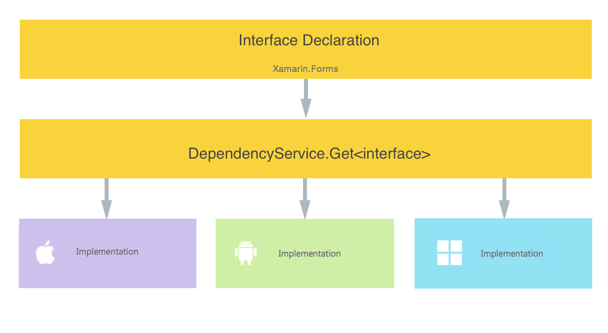
Dependency Service
Allows apps to call into platform-specific functionality
Write and inject your own platform-specific services

Slide 26
Using Dependency Service
Xamarin Forms apps need 4 components to use Dependency Service
Interface
Implementation Per Platform
Registration
Call to Dependency Service

Slide 27
Creating Dependency Service
→
Let’ Builds an App

Slide 28
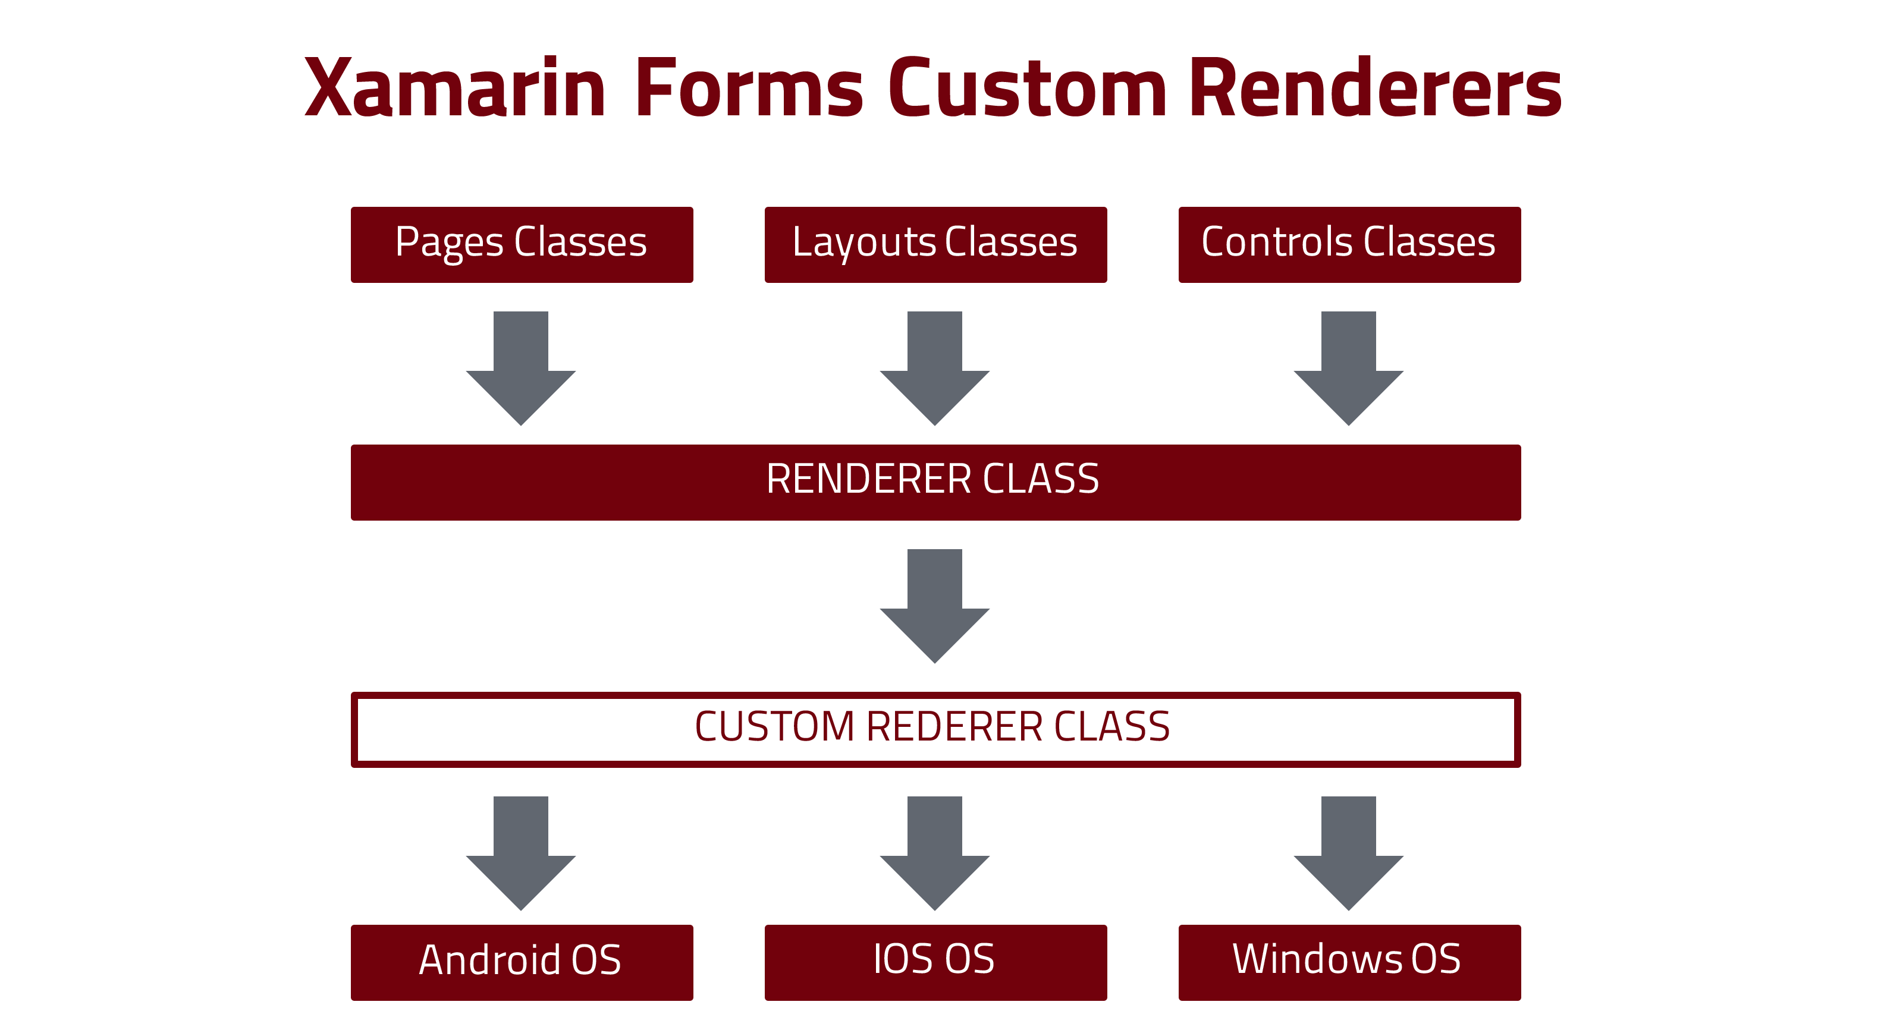

Slide 29
Xamarin Forms Custom Renderer
Customizing appearance and behavior of Xamarin Forms controls
Small styling changes or sophisticated platform-specific layout and behavior customization
Why custom renderers are required?

Slide 30
Creating Custom Renderer
→
Let’ Builds an App

Slide 31
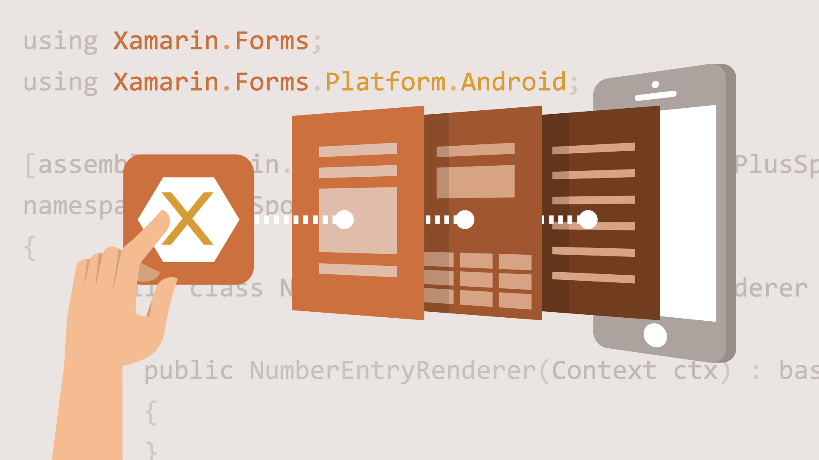
Custom Control
What is custom control?
A customized view that meets custom requirements.
Why custom control?
Maximise code sharing
Minimise code duplication

Slide 32
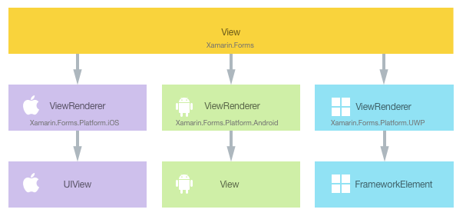
Custom Control
A customized view that meets custom requirements.
Why custom control?
Maximise code sharing
Minimise code duplication

Slide 33
→ Let’s create a Custom Control

Slide 34
Slides and Demos
https://github.com/harikrishnann/CustomControl-CustomRenderer-DataBinding-DependencyService

Slide 35
Thank you ☺
Any Queries?
Harikrishnan
cnharishkrish@gmail.com
https://www.linkedin.com/in/hari-krishnan-304a0272
cn_harikrishnan

